Slide 1



Technical Writer Test - Publishing a Collateral
January, 2021

Slide 2
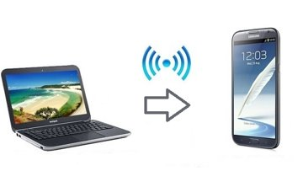
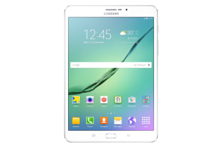
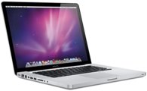
Introduction
mSeries™ lets back office users publish and control content sent to field users in a simple and direct way. Back office teams have all the necessary tools to establishing the target audience, the validity period of the document being shared and even monitoring how often the file is accessed. Thus, mobile users have access to up-to-date content when and where they need it.

Slide 3
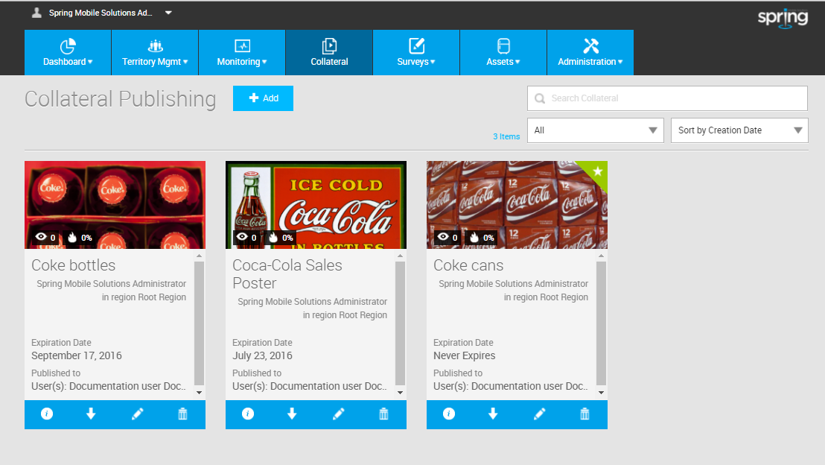
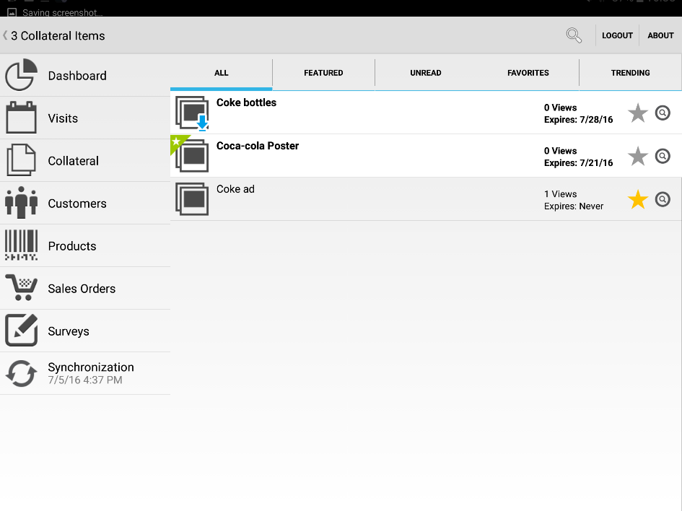
What is the mSeries™ Collateral module?
Collateral, in marketing and sales, is the collection of materials used during the sale and distribution of a product - like brochures, folders, etc. The Collateral module allows publishing documents directly to field users (Example: all users from region X receive a specific collateral) or indirectly to users (Example: all users who visit customer X receive a specific collateral).
Back office (Web Portal)
Field User (Mobile app)

Slide 4
Publishing collaterals
Step 1: […]

Slide 5
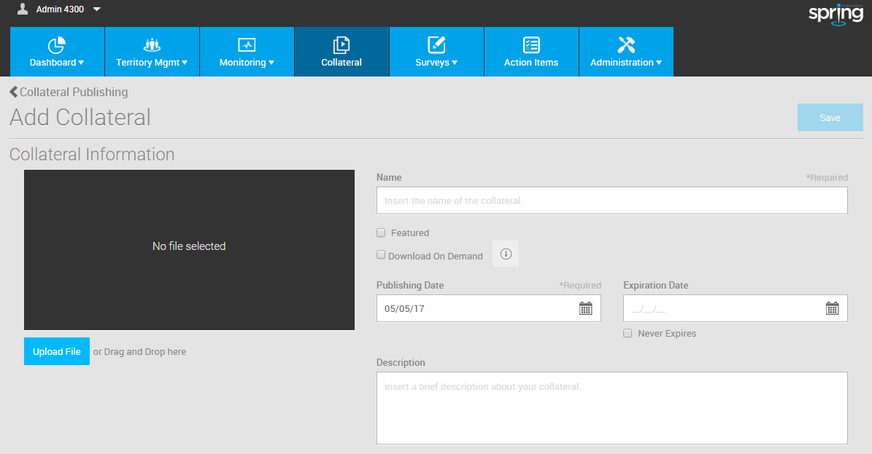
Publishing collaterals
Step 2: […]

Slide 6
Publishing collaterals
Step 3: […]

Slide 7
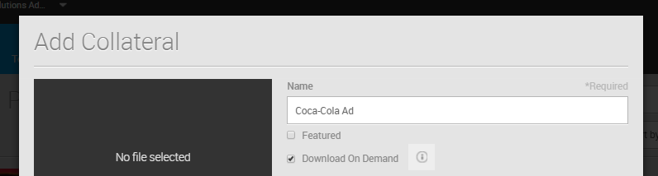
Publishing collaterals
Step 4: […]

Slide 8
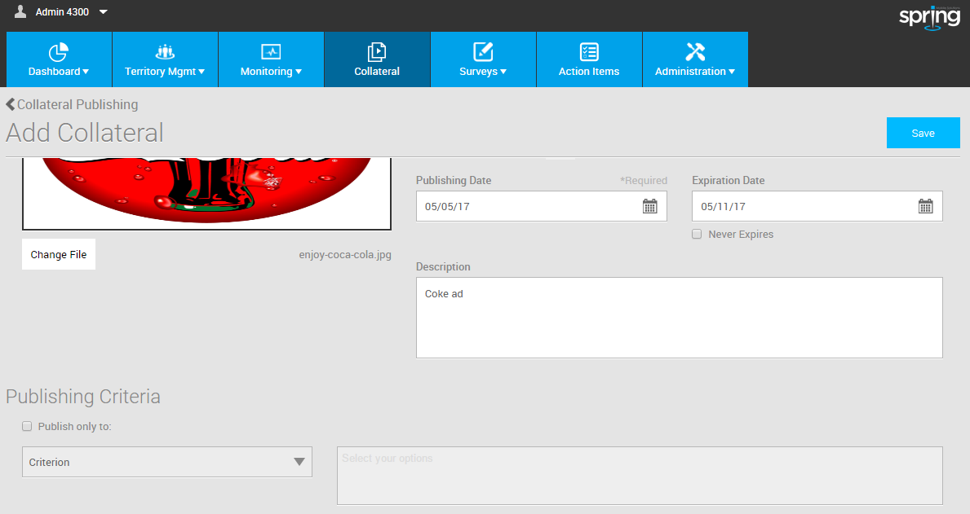
Publishing collaterals
Step 5: […]

Slide 9
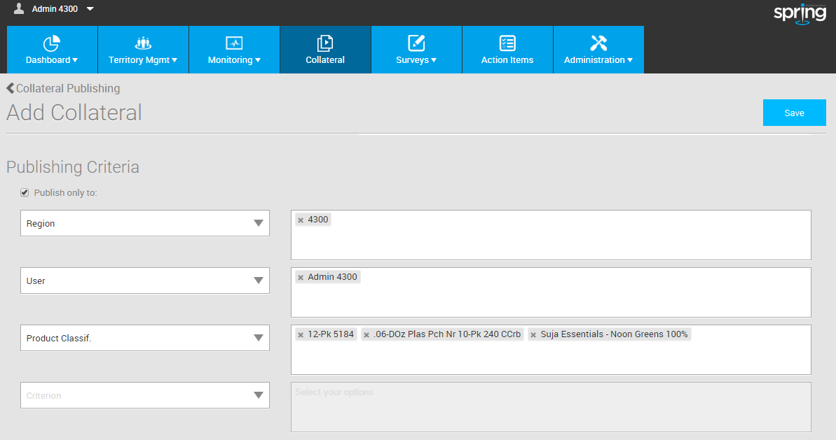
Publishing collaterals
Step 6: […]

Slide 10
Publishing collaterals
Step 7: […]

